Slide 1

CL 299 Mid-Sem Presentation ​​
​
LNP Manufacturing and Process Simulation
Special thanks to Prof. Kaustubh S. Rane for invaluable guidance and for giving us this opportunity.
Presented by:
Rhythem Soni 24110296
Aman Bola 24110032
Saket Jonwal 24110311
​

Slide 2
Objective of the Project
To develop a process-level understanding of commercial-scale Lipid Nanoparticle (LNP) manufacturing for mRNA drug delivery.
Directly injected mRNA would be rapidly degraded by enzymes in the body before it can reach and enter cells.
So, mRNA strands are encapsulated inside LNPs to deliver them to target cells.
To systematically study: Feed composition Mixing technologies Downstream processing Process Analytical Technology (PAT)
To use this understanding as a foundation for process simulation.

Slide 3
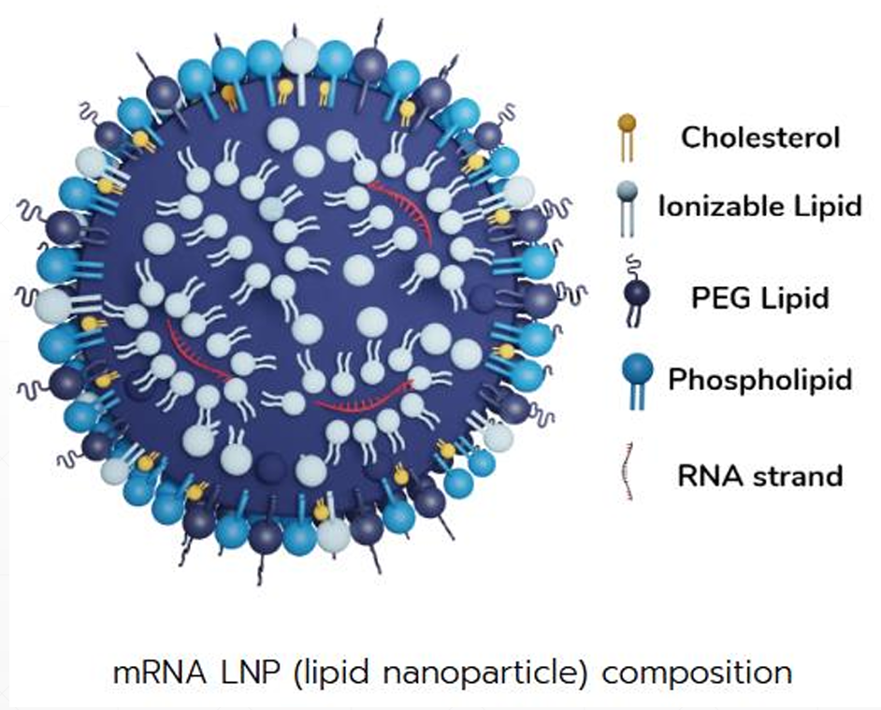
LNPs and their Composition
Lipid Nanoparticles are tiny spherical particles made of lipids of nanometer size (10nm to 100nm).
They encapsulate and protect fragile molecules like mRNA to reach and enter in cells efficiently.
Detailed study of LNP composition
Ionizable lipids → RNA binding & endosomal escape
Helper lipids → structural stability
Cholesterol → membrane rigidity
PEG-lipids → size control & colloidal stability
Composition directly affects CQAs (size, PDI, encapsulation)
Initially Liposomes were used for drug delivery, but LNPs have higher encapsulation efficiency, excellent scalability and reproducibility, and have efficient endosomal escape than liposomes.

Slide 4
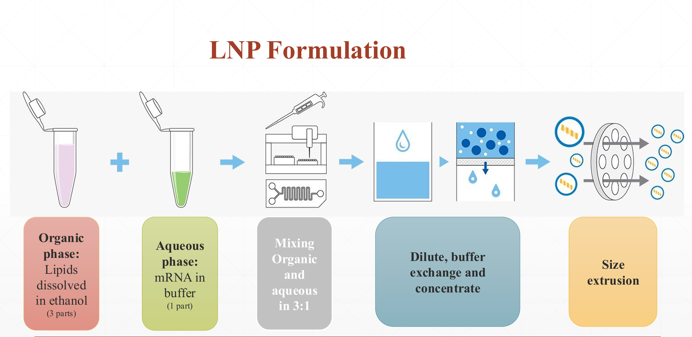
Image Source - https://www.wyatt.com/solutions/lnp-formulation.html

Slide 5
Feed Composition & Ratios
Aqueous Feed
mRNA dissolved in buffer
Buffer concentration ≤ 25 mM
pH ≈ 4 during mixing
Importance of Mixing
Mixing time and method control LNP self-assembly, particle size, and uniformity (PDI).
Proper rapid mixing ensures homogeneous conditions and high mRNA encapsulation efficiency, improving drug loading.
Organic Feed
Lipids dissolved in ethanol
Total lipid concentration ≈ 10 mM

Slide 6
Design Space
Component | Allowed Range (mol%) | Preferred Range (mol%)
Ionizable lipid | 10 – 60 | 30 – 40
Helper lipid | 5 – 30 | 10 – 20
Sterol | 5 – 70 | 10 – 50
Lipopolymer | 0.5 – 50 | 1 – 5
Obtaining structurally distinct LNPs often requires drastically changing the chemical composition.

Slide 7
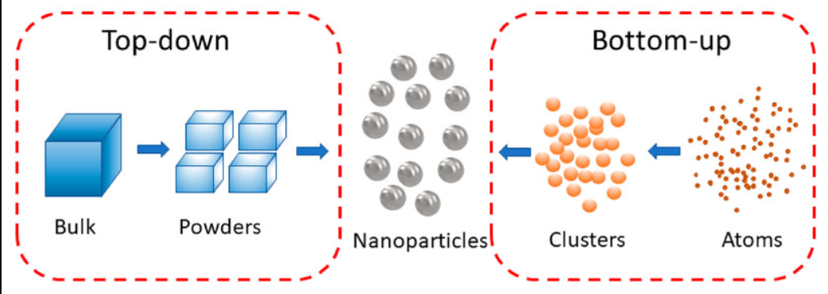
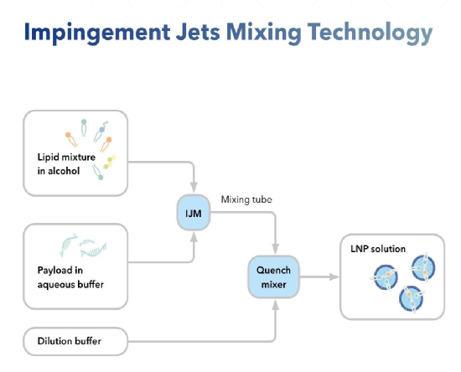
Mixing Technologies
Surveyed mixing approaches
Top-down vs Bottom-up
Thin-film hydration
Manual mixing
SCF methods
Microfluidics – NxGen Technology
Macrofluidics – Impingement Jet Mixing (IJM) "In IJM two liquid streams collide head-on at high velocity which creates intense turbulence. Hence, LNPs are formed by self-assembly".
https://www.researchgate.net/publication/346634789/figure/fig1/AS%3A983460407697408%401611486641333/Scheme-of-top-down-and-bottom-up-synthesis-of-nanoparticles-NPs.jpg

Slide 8
Downstream Processing
Quenching by dilution : Quenching by dilution is the rapid addition of buffer after mixing lipids (in ethanol) and RNA (in aqueous phase) to immediately reduce ethanol concentration and stop further particle growth.
Tangential Flow Filtration (TFF) : Tangential Flow Filtration (TFF) is a membrane-based separation technique where liquid flows parallel to the membrane surface, allowing small molecules (like ethanol, salts, impurities) to pass through while retaining LNPs.
Sterile Filtration : Sterile filtration is the passage of LNP solution through a micro membrane filter to remove microorganisms.
Fill-finish and storage : Fill–finish is the aseptic filling of the sterile LNP formulation into vials or syringes, followed by sealing and labeling.

Slide 9
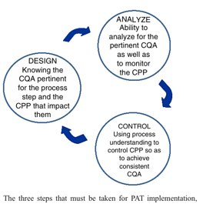
Process Analytical Technology(PAT)
Framework for real-time monitoring, analysis, and control of pharmaceutical manufacturing processes.
It mainly focus on – 1. Critical Quality Attributes (CQAs) 2. Critical Process Parameters (CPPs)
PAT integrates process understanding, real-time analysis, and control to ensure product quality.

Slide 10
Some analytical techniques used in PAT
Dynamic Light Scattering (DLS)
Zeta Potential Analysis
X-ray Diffraction (XRD)
Mass Spectrometry (MS), etc.
PAT Tools
Multivariate tools for design, data acquisition, and analysis
Process analyzers
Process control tools
Continuous improvement and knowledge management tools
An appropriate combination of some or all of these tools may be applicable to a single unit operation or to an entire manufacturing process and its quality assurance.
10

Slide 11
PAT Measurement Level
Describe how closely an analytical method is connected to the manufacturing process and how useful it is for real-time control.
Four Analytical levels: Offline: analysis after sample removal At-line: analysis near the manufacturing line Online: automated sampling and analysis loop In-line: sensor placed directly in the process stream
Process relevance and control capability increase from offline to Inline.

Slide 12
What Next: Process & Technology Development
Develop detailed chemical-engineering style process flowcharts
Prepare separate flowcharts for:
Lab scale
Intermediate / clinical scale
Industrial scale
For each unit operation, identify:
Technologies used (from patents & literature)
Scale-dependent differences (lab vs industry)
Focus on real processes, not conceptual diagrams

Slide 13
Data Catalogue, PAT & Code Prep
Create exhaustive patent-based material catalogue:
Ionizable lipids, helper lipids, sterols, PEG-lipids
Include molecular weights for mol–mass conversion
→ Prepare basic Python data lists (not full simulation yet)
Expand PAT mapping:
Classify PAT tools as inline / online / at-line / offline
Include sensors: pH, temperature, flow, pressure, particle size
Use patents & research papers only as sources

Slide 14
Resources
M. J. Abrams et al., "Compositions and methods for delivering messenger RNA," U.S. Patent 11,191,849, Dec. 7, 2021.
S. Panzner et al., "LNP compositions comprising RNA and methods for preparing, storing and using the same," U.S. Patent Application 2023/0414747 A1, Dec. 28, 2023.
A. Tam et al., "Lipid nanoparticle formulations for optimal RNA-based topical delivery to murine airways," Eur. J. Pharm. Sci., vol. 176, p. 106234, Aug. 2022.
A. S. Rathore, R. Bhambure, and V. Ghare, “Process analytical technology (PAT) for biopharmaceutical products,” Analytical and Bioanalytical Chemistry, vol. 398, pp. 137–154, 2010, doi: 10.1007/s00216-010-3781-x.
A. Chanda et al., “Industry Perspectives on Process Analytical Technology: Tools and Applications in API Development,” Organic Process Research & Development, vol. 19, pp. 63–83, 2015, doi:10.1021/op400358b.
J. A. Kulkarni, D. Witzigmann, S. Chen, P. R. Cullis, and R. van der Meel, “On the role of helper lipids in lipid nanoparticle formulations of siRNA”, vol. 13, no. 3, pp. 203–213, Mar. 2018, doi: 10.1038/s41565-018-0039-3.

Slide 15
J. Schoenmaker, E. Witzigmann, J. A. Kulkarni, R. van der Meel, and P. R. Cullis, “mRNA-lipid nanoparticle COVID-19 vaccines: Structure and stability,” International Journal of Pharmaceutics, vol. 601, art. no. 120586, Jun. 2021, doi: 10.1016/j.ijpharm.2021.120586.
X. Hou, T. Zaks, R. Langer, and Y. Dong, “Lipid nanoparticles for mRNA delivery,” Nature Reviews Materials, vol. 6, no. 12, pp. 1078–1094, Dec. 2021, doi: 10.1038/s41578-021-00358-0.
S. Chen, Y. Y. C. Tam, P. J. C. Lin, A. K. K. Leung, and P. R. Cullis, “Development of lipid nanoparticle formulations of siRNA for hepatocyte gene silencing following subcutaneous administration,” Organic Process Research & Development, vol. 18, no. 3, pp. 491–497, 2014, doi: 10.1021/op400358b.
Links: https://insidetx.com/resources/reviews/lnp-synthesis-overview-of-the-manufacturing-methods/ https://drive.google.com/drive/folders/10AyL6bArZ2kjxkyHl5krHhYheAy40hMO?usp=drive_link

Slide 16
THANK YOU!!!

